Slide 1
Landmines of Computer Use

Slide 2
We can be like the ostrich or take control…

Slide 3
What are our Landmines?
Protecting our passwords.
Keeping our privacy on the internet.
Keeping our devices safe.

Slide 4
55% of net users use the same password for most, if not all, websites. When will they learn?

Slide 5
Choose a strong Password
Yup, we really are terrible at those passwords & password recovery questions.

Slide 6
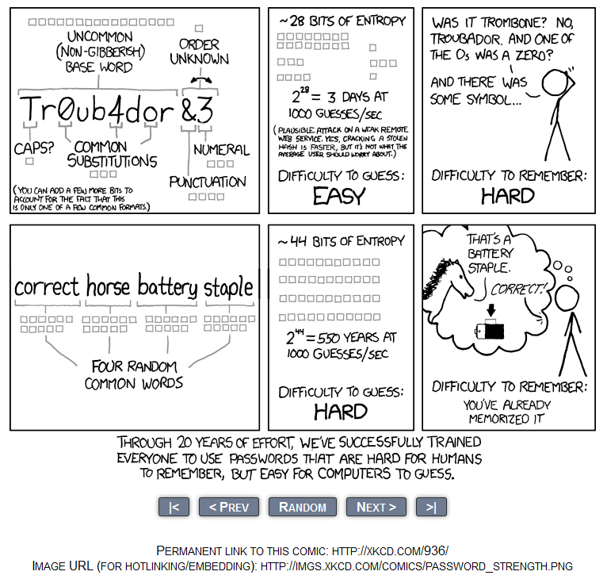
Choose a strong Password – long and unique and use 2-factor if available.

Slide 7
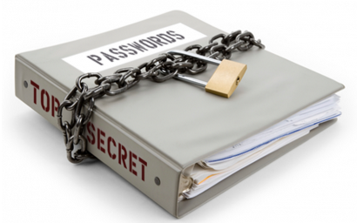
What can I do about Passwords?
If you have to write it down then lock it up. (away from the computer)
Use Excel or Word and password protect the document.
Use a passphase scheme.
Use a password manager.
Notes:
Retirementmeans2Eat,Drink&beMerry
PickleballrVolcanoPinappleSmorkeling

Slide 8
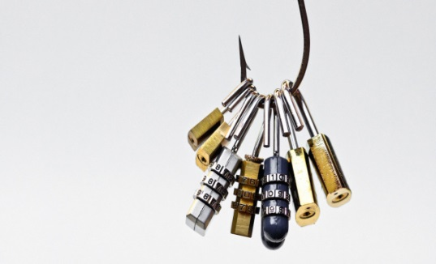
Encrypt a document
Go to Security.tcu.edu
Home--› Securing Your Devices--› Data Encryption
https://security.tcu.edu/securing-your-computer/data-encryption/
Open NotePad and Excel

Slide 9
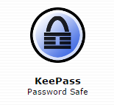
Password Manager
LastPass - https://lastpass.com/
KeePass - http://keepass.info/
1Password - https://agilebits.com/onepassword
Dashlane - https://www.dashlane.com/
Notes:
Some password managers store the information locally, while others store it in the cloud.
Regardless of where it is stored, is it encrypted?
Many allow you to decide which devices are permitted to access/store the password database and where they can be accessed (based on geo-IP).

Slide 10
LastPass example
Notes:
Demo – tcupenni@yahoo.com
Show adding new site.
Password setup
Create new password
Organize
Start slow…only few until you get used to it.

Slide 11
Keeping our privacy on the Internet

Slide 12
Is Social Media Ever Safe?
Slow down and think before you click on links and videos.
Do you really want to give away information about yourself?
Notes:
Show Security Check tool.

Slide 13
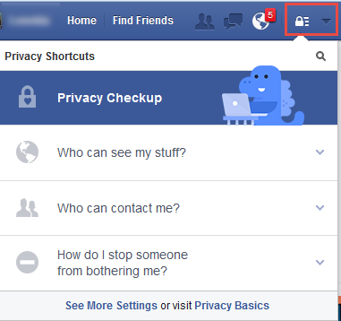
Facebook Privacy Checkup
Notes:
Show Security Check tool.

Slide 14
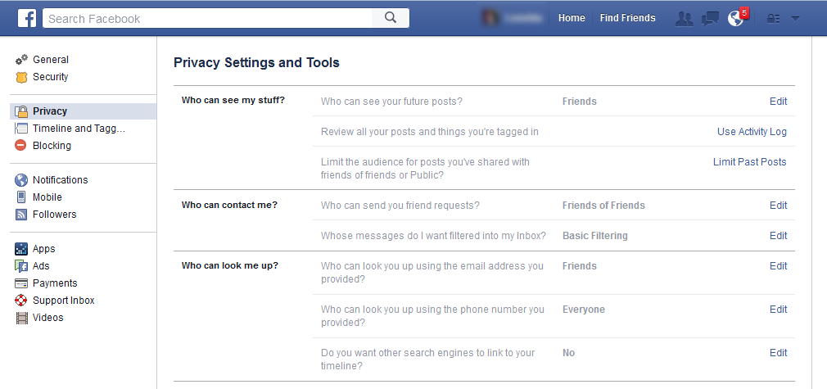
Facebook Privacy Settings & Tools
Notes:
Show Security Check tool.

Slide 15
Facebook - View As
Notes:
Show Security Check tool.

Slide 16
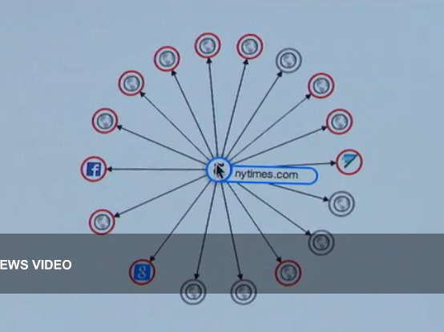
Who’s watching you as you browse the internet?
Every page you visit on the web is full of third parties tracking your clicks.
60 Minutes – August 24, 2014
http://www.cbsnews.com/news/shocked-to-learn-how-data-brokers-are-watching-you/
Notes:
This past summer 60 minutes had a segment on your online privacy. One of the things I found interesting is that every time we go to a website, ones like the NewYork Times or Weight Watchers there are many third parties there tracking your clicks storing our likes and preferences all in the name of providing us customized marketing and information. They said there are 1500 data points on each individual.
So we have to ask ourselves where is this “big data” being stored, how safe is it and did I really give away my personal information?

Slide 17
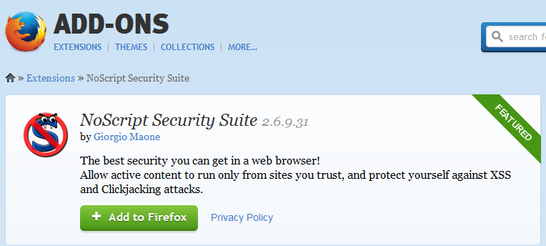
Safer Browsing?
Notes:
Show Security Check tool.
Cnet Video
Example – my browser
Temp allow
msn/yahoo
Adobe
Add Ran

Slide 18
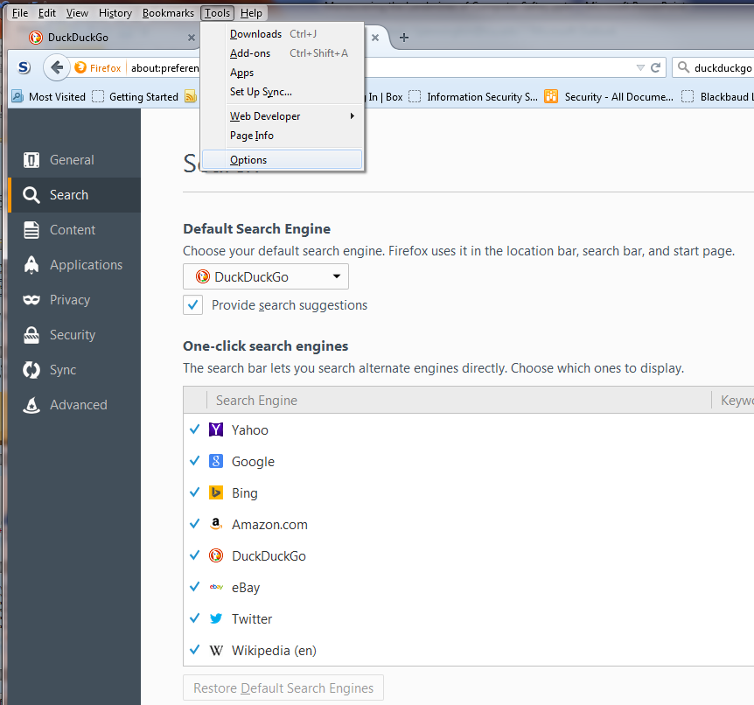
Anonymous Browsing - DuckDuckGo
DuckDuckGo Plus for Firefox is an extension for Mozilla Firefox. It is a search engine that does not track you.
It does not show 3rd party where you have come from or where you go.
Notes:
Show Security Check tool.

Slide 19
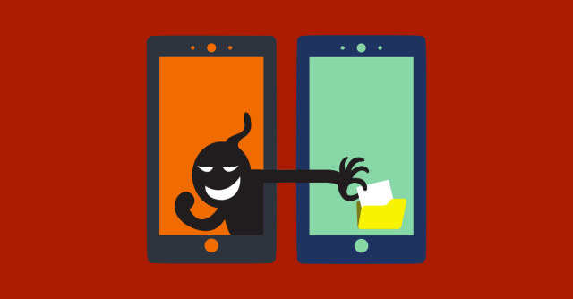
Mobile Safety
Why you shouldn't worry about privacy and security on your phone
Notes:
Show Security Check tool.

Slide 20
Do something proactively to protect yourself.

Slide 21
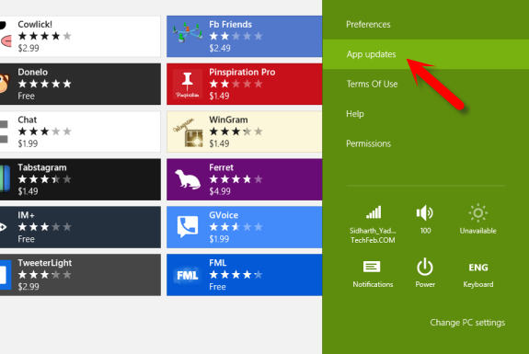
Update, Update, Delete
Keep All your Devices patched.
Operating system and applications updated.
Turn on Automatic updates.
Delete Old programs you don’t use.

Slide 22
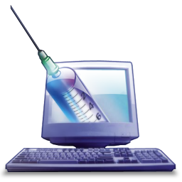
Always use Anti-virus program!

Slide 23
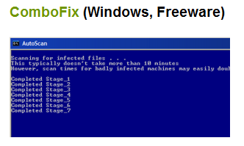
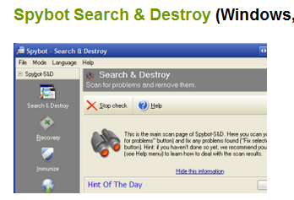
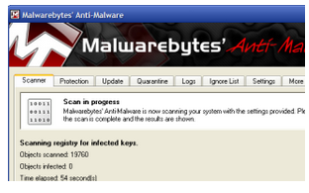
Malware Removal
Notes:
You download ComboFix, run it, and it takes care of the rest.
Malwarebytes' flagship application Anti-Malware is a shareware malware-removal tool. The principle difference between the free and premium version of the application is real-time monitoring. If you don't need active scanning against threats, the free version uses the same database and does an admirable job ferreting out infections.
Spybot has been around since Windows 95 and has continuously ranked high among malware removeal tools.
Download sites: Bleepingcomputer.com, download.com, malwarebytes.org

Slide 24
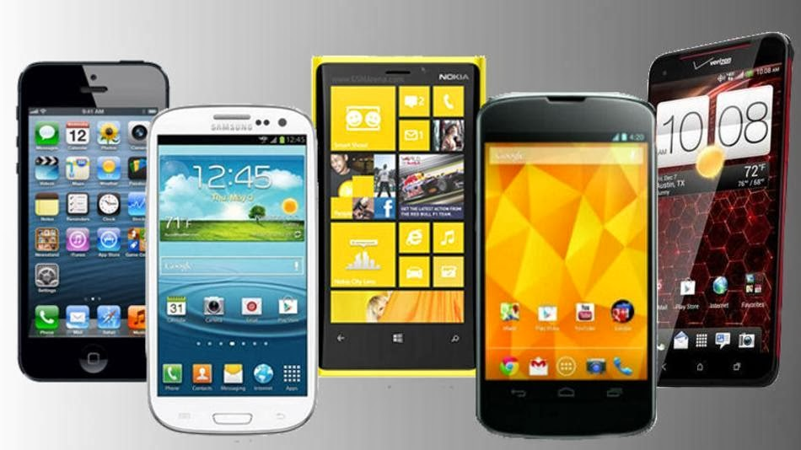
Mobile Safety
Set up a password Keep OS & Apps up-to-date
Turn off Location services for most apps
Don’t jailbreak your device
Notes:
Show Security Check tool.

Slide 25
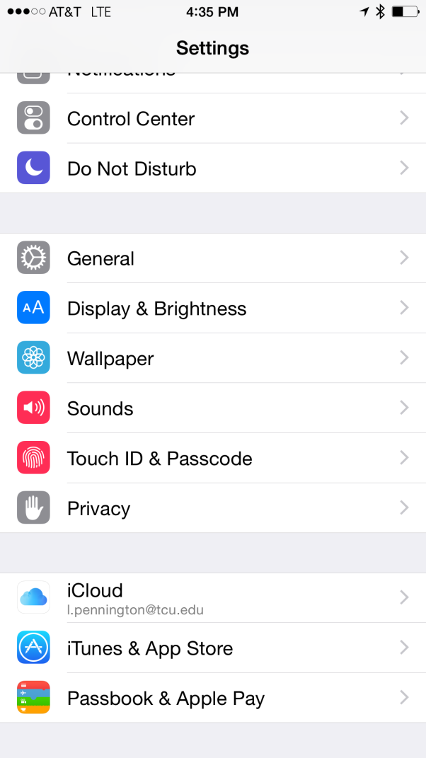
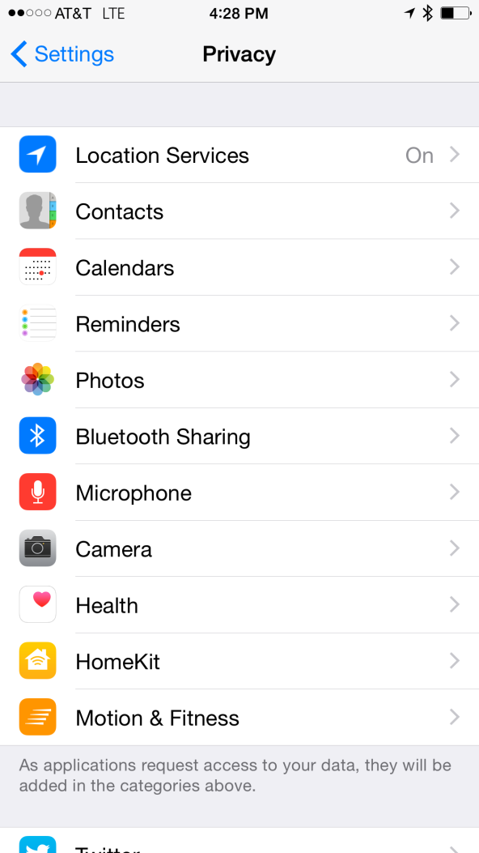
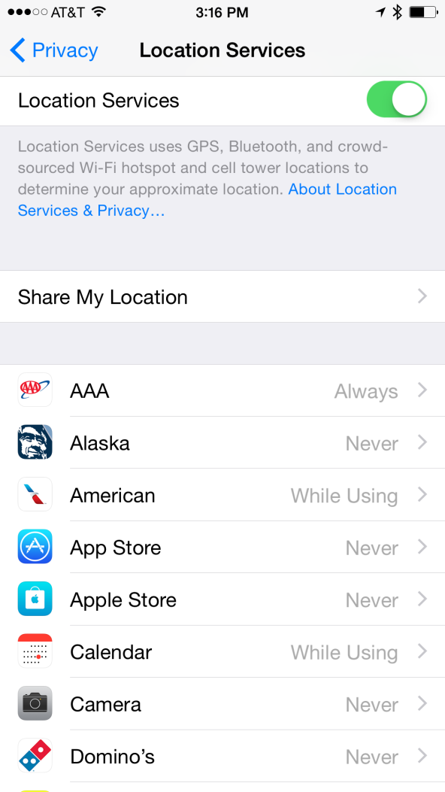
Turn off Locations Services for most Apps

Slide 26
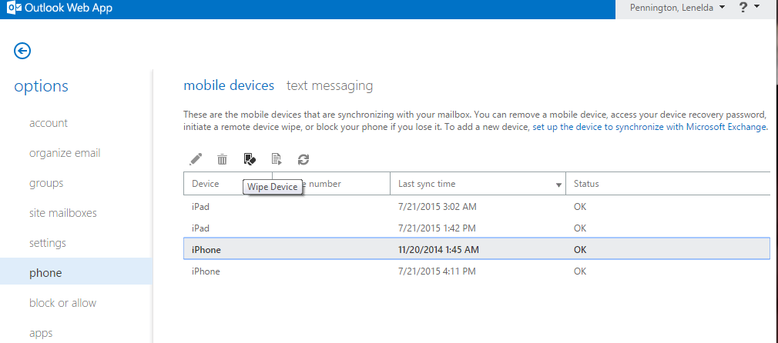
Loose your phone or tablet…
Wipe it using your phone app or OWA.

Slide 27
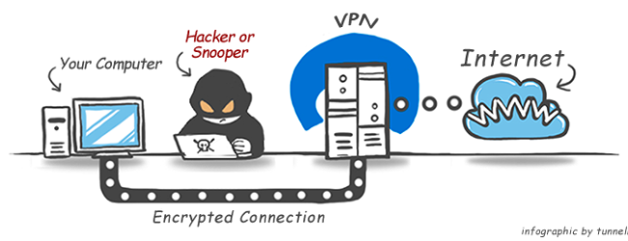
Use TCU’s VPN to avoid possibility of giving away your passwords or personal information.

Slide 28
What is VPN?
Virtual Private Network
This allows you to “re-source” your network traffic from an unpredictable remote location to one you know like the TCU Faculty/Staff network so it seems like you are working at TCU.
Con –
Could be a little slower
TCU logs your traffic
Pro – As secure as if you were at work.
Others can’t sniff your clear text passwords.
It neutralizes the risk of possibly hacked Wi-Fi access points.
Allows access to Resources limited to TCU ip addresses like Library DB. (consumer reports, ancestory.com)
*VPN does not make you look anonymous.
Notes:
Don’t don’t type PII on any Public Computers! (even with VPN)

Slide 29
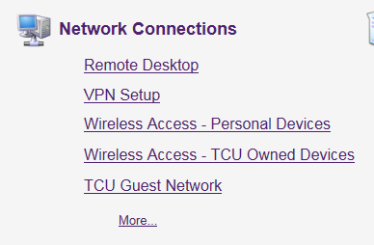
VPN & RDP at TCU
Go to it.tcu.edu → Knowledgebase→Sign In
Choose Employee→Faculty/Staff Knowledgebase Dashboard
Network Connections
Or Call 817-257-6855

Slide 31
More Tips!
Don't Let Spammers See Your "Out of Office" Replies’
Be careful with cybercafe/business center computers
Print out important documents
Avoid opening email attachments
Turn off your wireless AP when it's not in use
Know your IMEI – if phone lost, you can block it from being used.
Don't enter your password on an untrusted computer.
Take time to explore security settings
Notes:
verify that the site is using encryption before you submit any information —
look for https in the web address and for a padlock or key in the lower right corner of your browser.
Don't send your personal information (social security number, credit card number, etc.) in an email or through instant messaging.
Cyber Café – Ok for browsing, not for email – Ok to VPN.
Print – CDs last abut 10 years, print important pictures & documents – back-up too.
Don’t open attachments – if from friend, read email before deciding.
IMEi - Press *#06# on your phone's keypad, and it will display a 15 digit number. Make a record of that number, it is your International Mobile Equipment Identity (IMEI) number; and, if the phone is lost or stolen, the phone can be identified even if a new SIM card is added. Your provider can also block others from using the phone on their network, which could help protect you against expensive 1-900 phone calls and similar mischief.
Security Settings
Whether it is financial management software, instant messaging or a social networking website, take the time to see what security settings are offered to protect you and your information. Follow these steps for all of the software you use, not just email.Go to Options or Preferences
Every program is different, so look for words like "Privacy", "Safety" or "Security" and click on them.
Select the most restrictive option (i.e. only let the people you approve view your information or contact you — or the one that best accommodates your business needs).
Save the settings.

Slide 32
Resources
Security.tcu.edu
Ouch Newsletter
Naked Security – Sophos
Krebs on Security
Password video
LassPass – getting started
NoScript tutorial
DuckDuckGo

